Slide 1

Predicting Deaths from Twitter(X) and COVID-19 Data
Group 2: Arya Gavande, Ezi Ilabor, Vincent Lu, Samir Mohs, Nishil Patel

Slide 2
Introduction
Can we predict daily COVID-19 death counts using :
Vaccination Rates
Seasons
Country
Public Sentiments on Social Media
Daily Vaccinations
with data coming from December 2020 to March 2022?

Slide 3
Datasets Information
 | Dataset 1: Daily COVID-19 Deaths | Dataset 2: Vaccine-Related Tweets | Dataset 3: Vaccination Rates
Info | Source: Scraped from Worldometer using BeautifulSoup; based on official government data (e.g., NHC of China). Time Span: Jan 24, 2020 – April 12, 2024. Observations: 1,549 rows. | Source: The tweets are extracted using a python script with the help of tweepy library. Please refer this notebook for the data extraction process https://www.kaggle.com/kaushiksuresh147/twitter-data-extraction Kaggle (#CovidVaccine hashtag collection) Time Span: Jan 8, 2020 – unspecified Size: Over 100,000 tweets | Source: From https://ourworldindata.org/ GitHub repository for COVID-19 which was accessed through kaggle Time Span: Dec 1, 2020 – Mar 28, 2022
Variables Used | Date: date of record (datetime) daily_increase_percent: daily death rate change (%) Season: Winter, Spring, Summer, Fall | Date: UTC timestamp of tweet text_sentiment: positive, neutral, or negative (via NLTK’s SentimentIntensityAnalyzer) user_verified: whether the account is verified user_since_days: days since account creation user_location: cleaned to standard country names | Date: date of record total_vaccinations_per_hundred: doses per 100 people daily_vaccinations: daily dose count vaccine_group: grouped into mRNA, Viral Vector, Inactivated, etc. country: used to merge datasets

Slide 4
Data Preparation
Merging & Sampling
Data Cleaning Steps
Final Dataset Summary
Standardized all Date formats to %Y-%m-%d.
Converted user_created to datetime.
Cleaned column names and removed irrelevant tweet locations (e.g., “moon,” “earth”).
Used pycountry to validate and clean user_location.
Dropped rows with missing key values to avoid bias
Time Span: Dec 25, 2020 – Mar 29, 2022
Structure: One row per country-date combination Content: Integrates tweet sentiment, vaccination rates, and COVID-19 deaths
Cleaned and structured for meaningful sentiment and trend analysis during the pandemic
Datasets merged on Date and standardized country.
Resulted in ~15,000 rows → reduced to 2,000 by sampling 100 tweets per month to ensure balance.

Slide 5
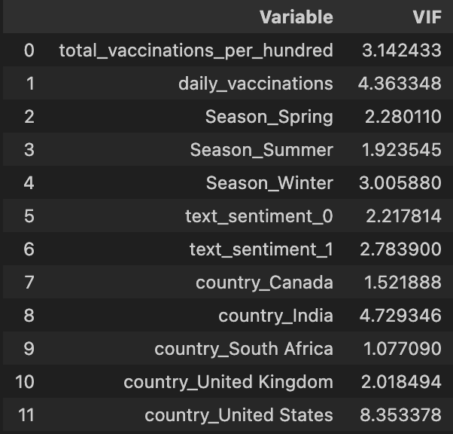
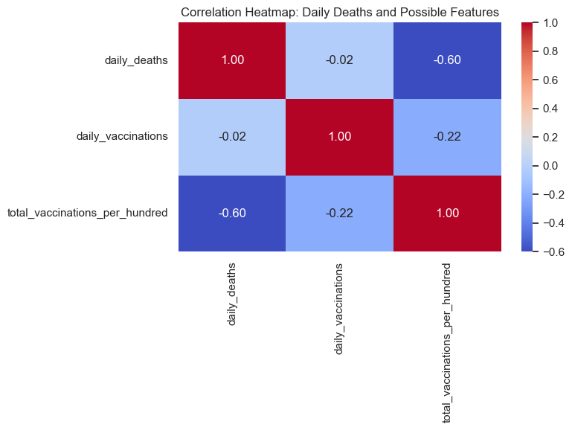
Initial Data Visuals
Correlation heatmap for numerical predictors
VIF table for all predictors

Slide 6
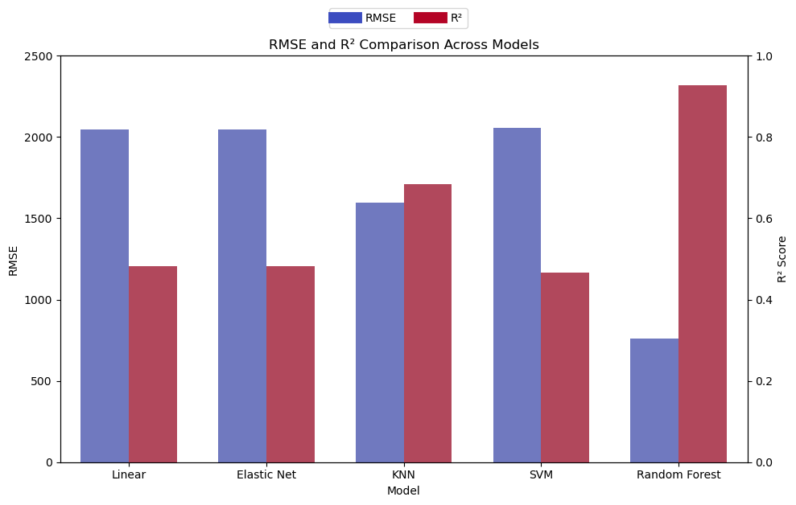
Modeling Process
Modeling Strategies after train/test split of 70/30 with random_state=42:
Multiple regression modeling strategies were used, such as Linear, Elastic Net, KNN, SVM, Random Forest, etc.
After testing multiple iterations of each model with fine tuned hyperparameters, Random Forest the best with max_depth=12.
Random Forest best at capturing unseen non-linear trends in data.

Slide 7
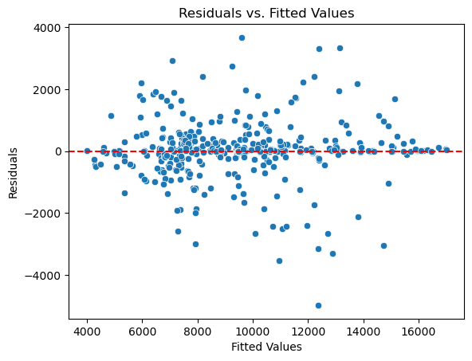
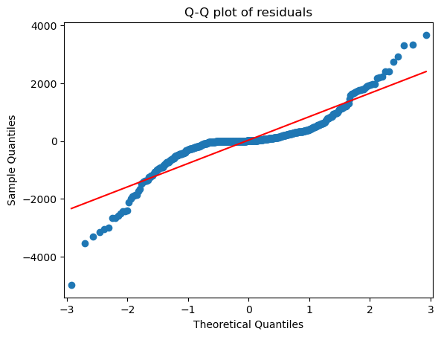
Model Assumptions
Independence and random sampling assumed, so all conditions met for valid modeling.

Slide 8
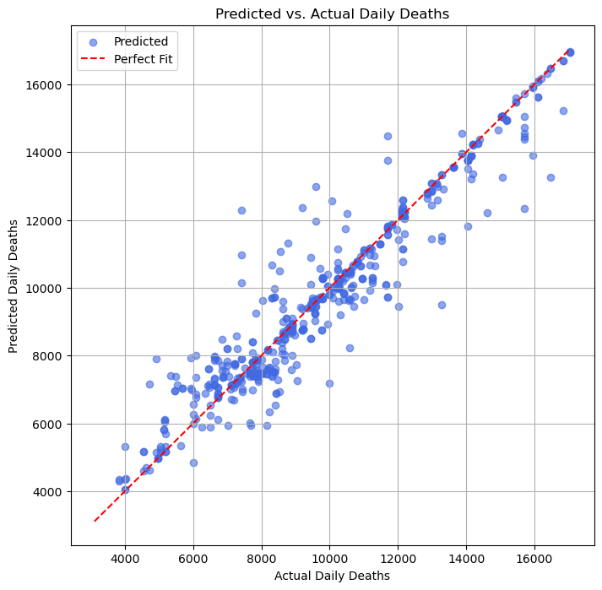
Model Performance
Performance assessment:
As seen, model is predicting reasonably well.
Average error minimized as best we could, as seen by the lack of variation between predicted vs. actual values
Could be improved with more features and data that could hopefully account for some of the outlying variation

Slide 9
Results
Daily Death Prediction Findings:
Higher vaccination rates generally correlated with lower daily deaths.
This relationship was influenced by season and vaccine type.
Tweet sentiment appeared to be a relevant factor in determining daily deaths.
Order of feature importance: vaccination rate, daily vaccinations, season, country, text sentiment.
Modeling Daily Deaths:
A Random Forest Regression model was best for predicting daily deaths.
Cross-validation results for different max_depth values were important for choosing the best model by capturing variable interactions.
R² score(0.92) and RMSE(810) indicated how well these factors predicted daily deaths.
Average error of around 810 deaths with around 92% of variance captured.

Slide 10
Conclusion
Findings
Implications
What Next?
Random Forest predicted daily deaths with 92% of variance accounted for (R² = 0.928).
Vaccination rates were the most important predictor.
Tweet sentiment had minor predictive power.
Models like SVM and Linear Regression performed worse, with higher error rates.
Add more records and richer features (e.g., hospital data, mobility, policy).
Explore how public sentiment affects behavior, not just outcomes.
Compare models across countries or phases of the pandemic.
Turn this approach into a real-time early warning system for health crise
Higher vaccine coverage is strongly linked to lower daily death rates.
Social media sentiment alone isn’t enough to predict health outcomes.
Machine learning can help identify public health risks earlier using vaccination data.
These tools could support data-driven pandemic response planning.

Slide 11
References
Chintalapudi, Nalini, Gopi Battineni, and Francesco Amenta. "Sentimental Analysis of COVID-19 Tweets Using Deep Learning Models." Infectious Disease Reports, vol. 13, no. 2, 2021, pp. 329–339. https://doi.org/10.3390/idr13020032.
Worldometer. “Coronavirus Death Toll Update - Worldometer.” Worldometers.info, Worldometer, 13 Apr. 2024, www.worldometers.info/coronavirus/coronavirus-death-toll/.
kaushiksuresh147. “Twitter Data Extraction.” Kaggle.com, Kaggle, 23 June 2021, www.kaggle.com/code/kaushiksuresh147/twitter-data-extraction. Accessed 30 Apr. 2025.
“Our World in Data - COVID-19.” Www.kaggle.com, www.kaggle.com/datasets/caesarmario/our-world-in-data-covid19-dataset.

